Slide 1

Video Game Sales Across the World
Increasing sales potential in many nations
Latrice

Slide 2

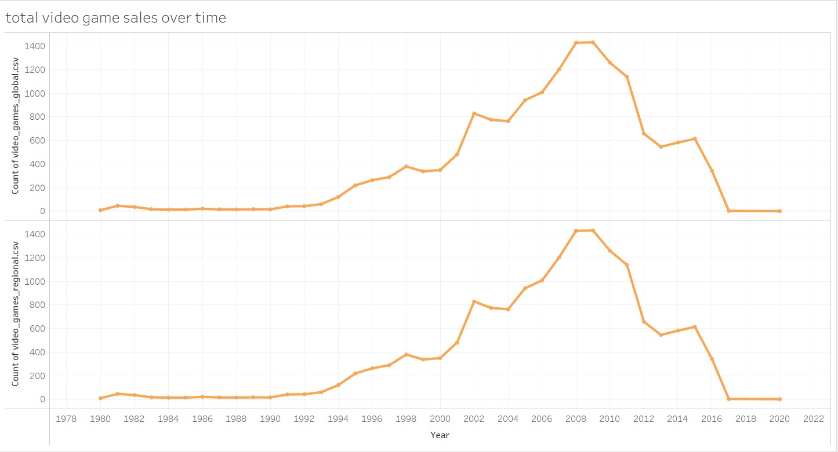
Over the years, video games sales have increased quite a bit!
But sales met their peak in 2009, and began to dip again. With 2020 forcing more people to stay inside and keep occupied and connected, we may see an increase in sales again

Slide 3
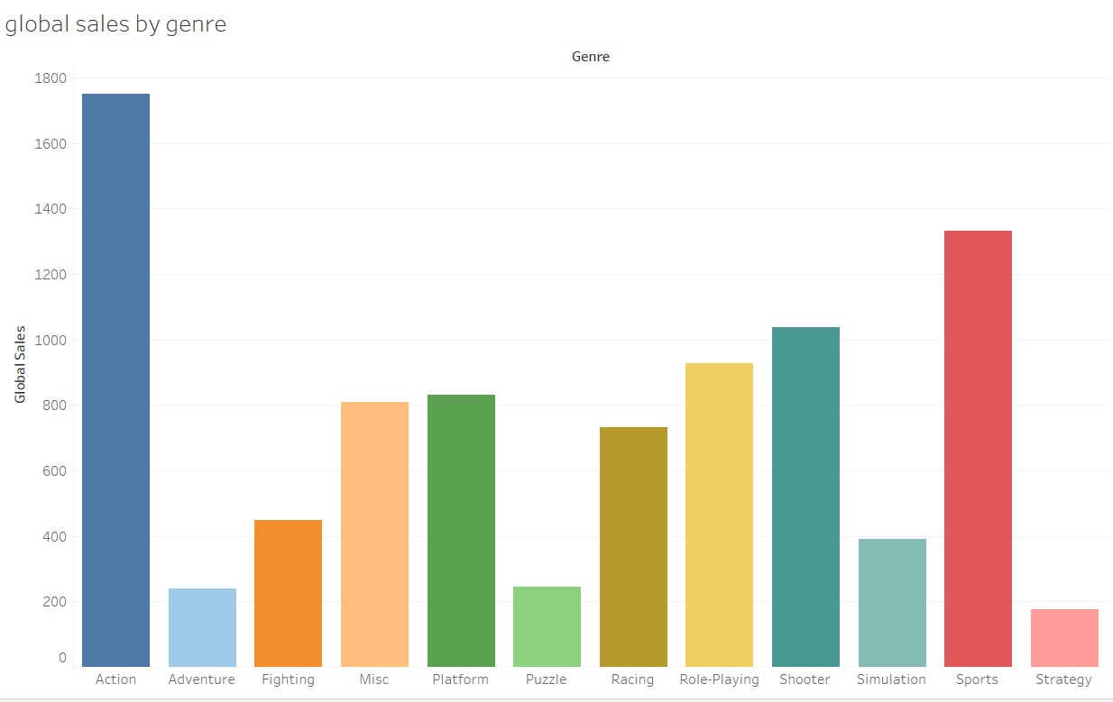
Globally, Action games dominate the field with sports coming in a close second. Games that include strategy, puzzle-solving, or adventure do not sell as readily.

Slide 4
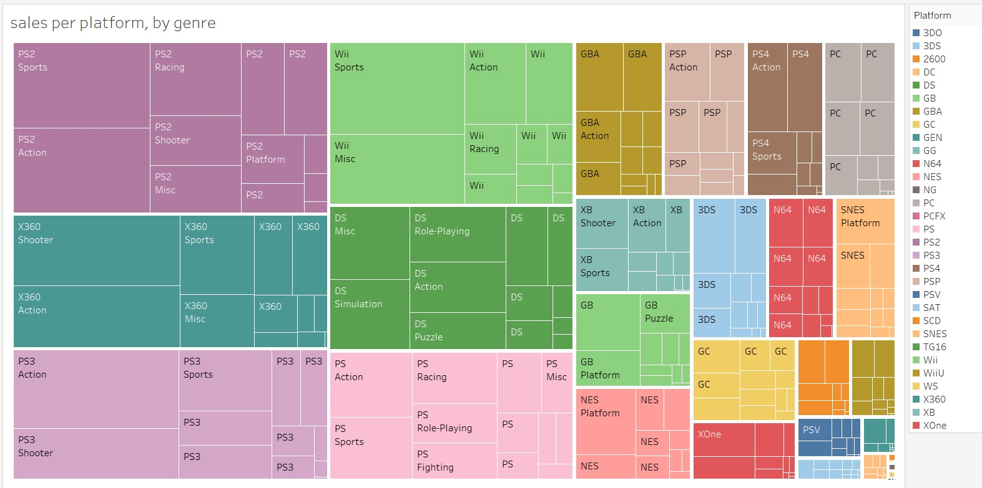
When we dive into the most popular platforms, PS2, Xbox 360, and PS3 take the top three spots respectively, with action once again being the popular genre of choice.

Slide 5
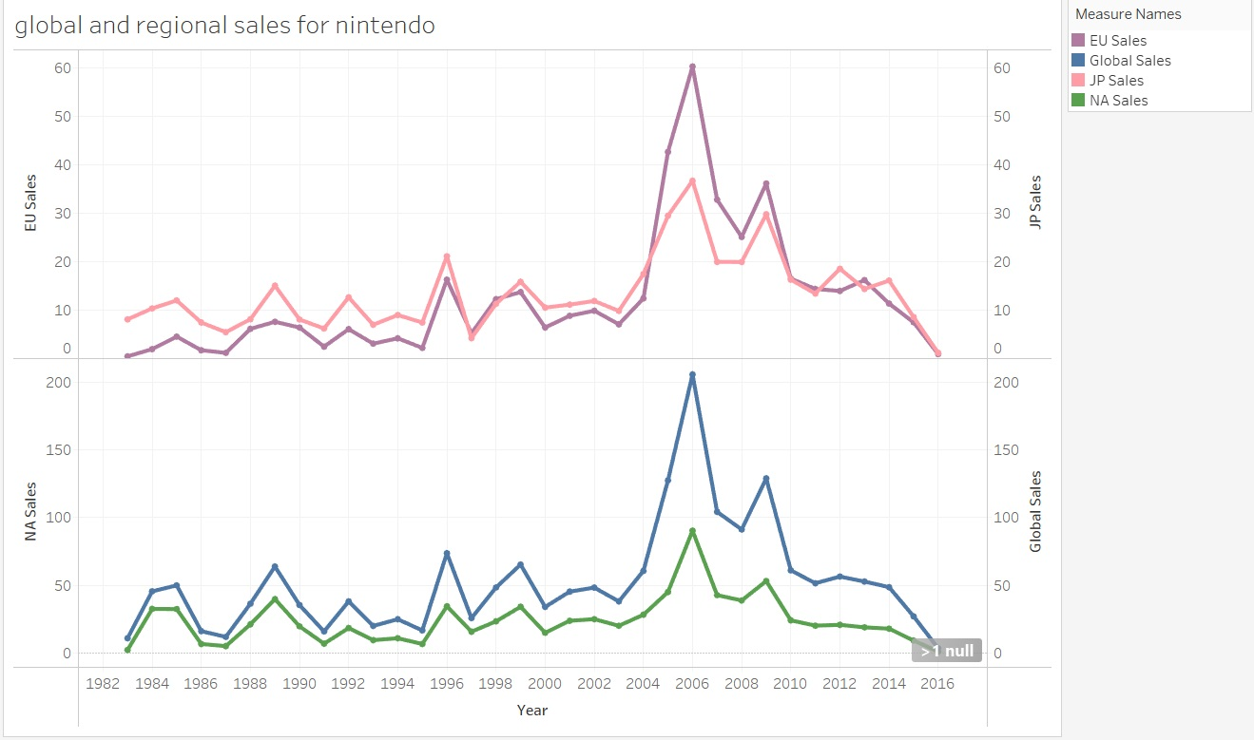
If we look at the big contender, Nintendo we see that sales spiked around 2006 and tapered off again after that. We are hoping the global state of things will bring gaming back to the forefront of the consumer industry.

